Slide 1

How health problems in the United States are becoming more prevalent as a result of the rise in fast food restaurants?

Slide 2




Objective
Rise in population and GDP of the country
Rise in household income and purchasing power of the consumer and more disposable income
Rise in consumption of fast-food trends and increase in revenue of fast food restaurants
Rise in premature health complications
We see this trend rise lately as a result of the following -

Slide 3



Who will be interested?
Health conscious people
New restaurants trying to enter the food and beverage industry
Government

Slide 4




Data Sets and Data Sources
For this project we have taken a sample of 5 companies as a representative of the entire Food and Beverage Industry.
The income statement for all these companies have been taken from https://www.investing.com/

Slide 5

Data Sets and Data Sources
The datasets about heart diseases and diabetes in United States has been taken from a government website
Centre for Disease Control and prevention - https://www.cdc.gov/nchs/fastats/heart-disease.htm

Slide 6

Data Sets and Data Sources
The data set for quarterly GDP of each state in the United States
https://www.statista.com/statistics/188185/percent-change-from-preceding-period-in-real-gdp-in-the-us/

Slide 7
Data Sets and Data Sources
The data set of the population census of each state and personal consumption of food and beverages is collected from a government website -
https://data.census.gov/cedsci/

Slide 8

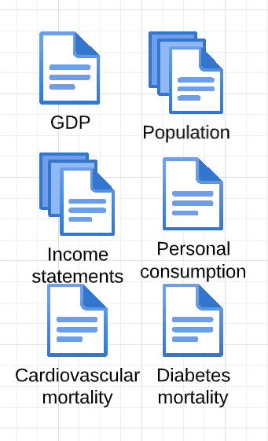

Data Wrangling Process
Subsetting and concatenation of data sets
Data collection
Null Values
Changing the data type of the columns
Removal of Inconsistent data
Forecasting incomplete data
Data Enrichment
Visualization
Raw Data

Slide 9
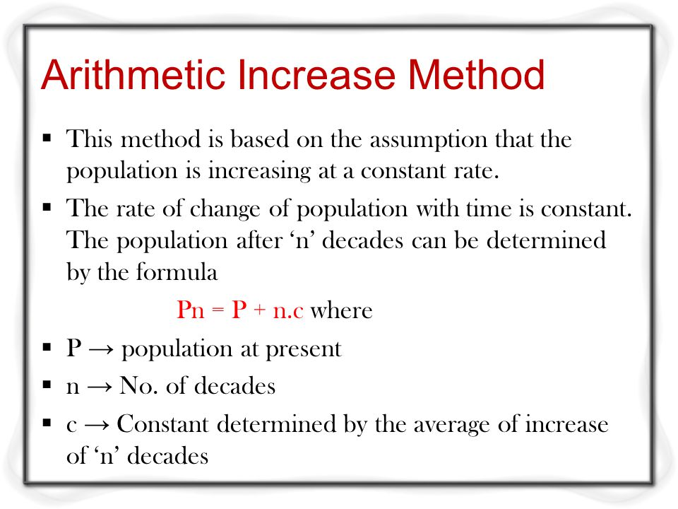
Arithmetic Increase Method to calculate the Cardiovascular and Diabetes data for 2020 and 2021

Slide 10
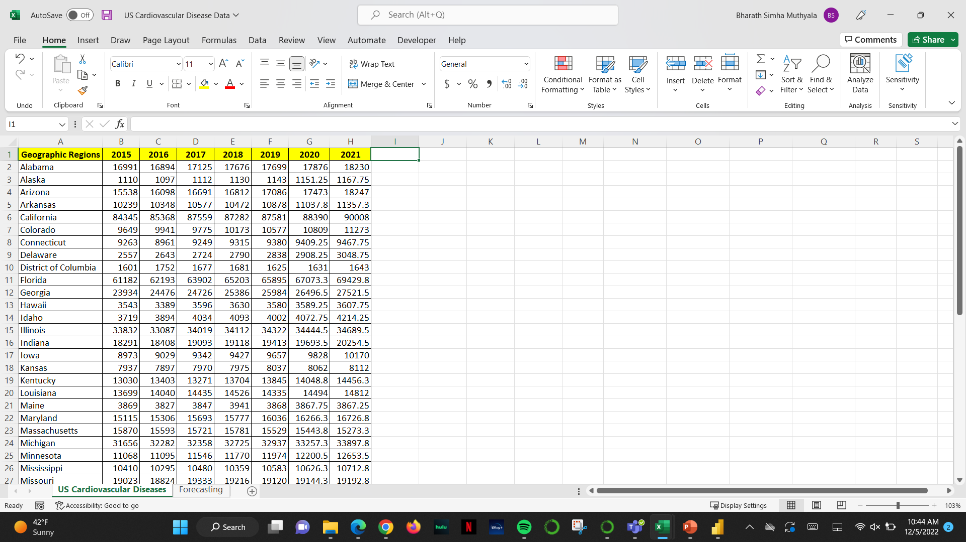

Slide 11
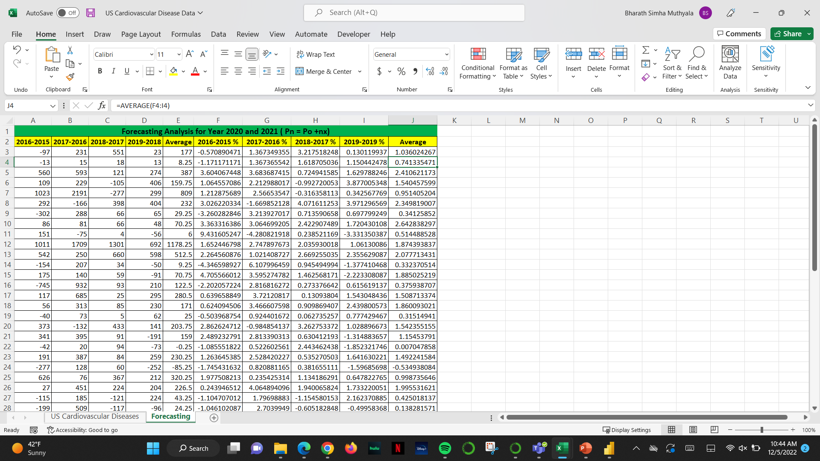

Slide 12
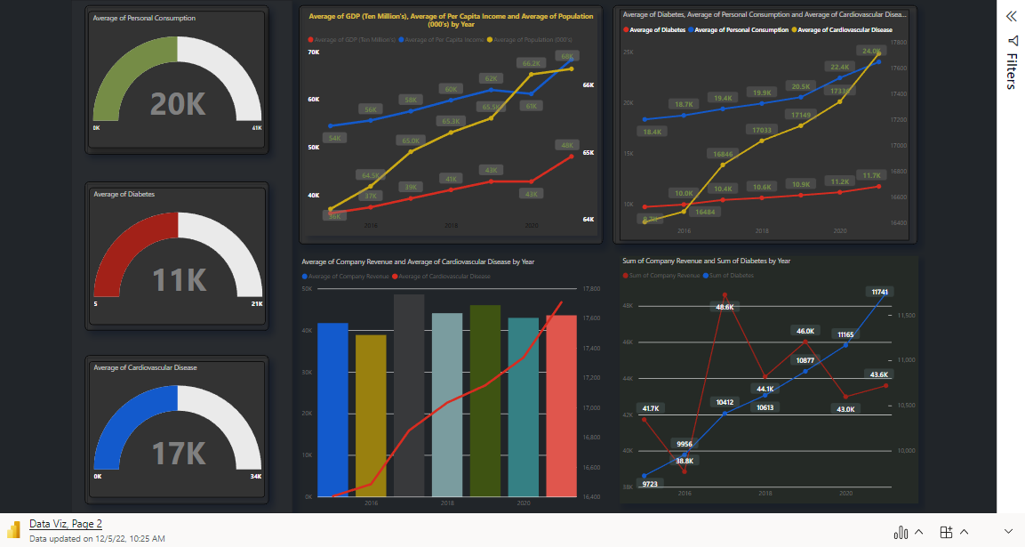
Result

Slide 13
Analysis of Result
On an Average an American spends $20,000 on of premises food and beverage consumption
There has been a positive correlation between the rise in standard of living of the consumers and increasing health complications among the subjects.
Fast-food restaurants revenue has a positive inline increase with Cardiovascular and Obesity Mortality in US

Slide 14
Challenges we faced
Finding the data for each US state
Detection of excess data in the US per capita income
Detection of excess and unnecessary data for state wise GDP

Slide 15
Future scope of the project
Detailed analysis - per US state wise.
We would have taken more health diseases.

Slide 16
Thank you

